Slide 1

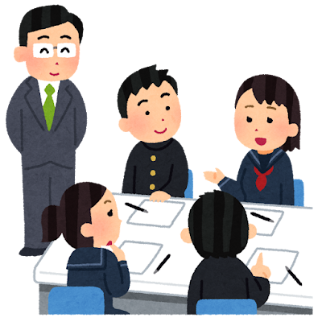





Infinitive Map Game!
Write a sentence together in 30 seconds.
“I went to ____ to ___.”
Make a group of 4-5.
Different
Prefecture = +1 point!
Same
Prefecture = +0 points for both.
+1
+1
+0
+0

Slide 2
Make groups of 4 people
Take 30 seconds to think of a prefecture and make a sentence.
“I went to Aomori to buy apples”
“I went to Tokyo to see Tokyo Skytree”
After the time, 1 person from the group will share the answer.
If your group is the only one who picks the prefecture, you get 1 point! And the prefecture is crossed out.
If 2 groups pick the same prefecture, nobody gets a point. And the prefecture is not crossed off.
Be sure to write it down so you can’t change your answer!
https://www.mapchart.net/japan.html

